Slide 1
CENG 232
Xilinx Installation
And
Basic Properties

Slide 2
Hardware Description Language
Designing schematics wire by wire is:
Hard
Error-prone
Gets more complex as project gets bigger
HDL
Describe your circuits as textual “code”, just like any programming language
Divide larger projects into smaller modules
Harder to visualize, but easier to manage

Slide 3
Hardware Description Language
Two popular languages:
VHDL
Complex at initial glance
Provides better control when synthesizing to physical elements
Verilog
Simpler syntax
Easier to learn

Slide 4
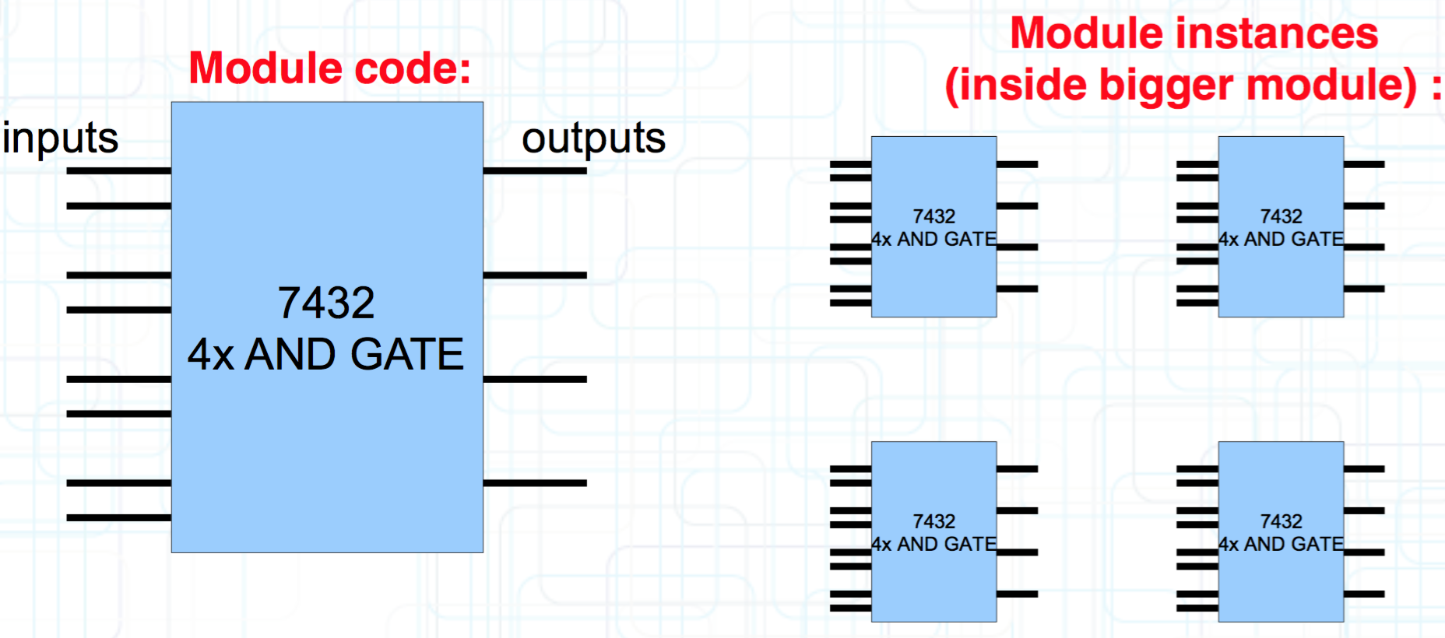
Modules
Modules
Modules are the building blocks of Verilog designs
Inputs
Outputs
Semantics between inputs and outputs

Slide 5
Testbench Idea
HDLs provide you a way to write modules
with their inputs and outputs
How to test it?
Create a test-module
instantiates your own module
writes to your module's inputs
reads from your module's outputs
Connect inputs and outputs of the test module to your module
Run the testbench

Slide 6
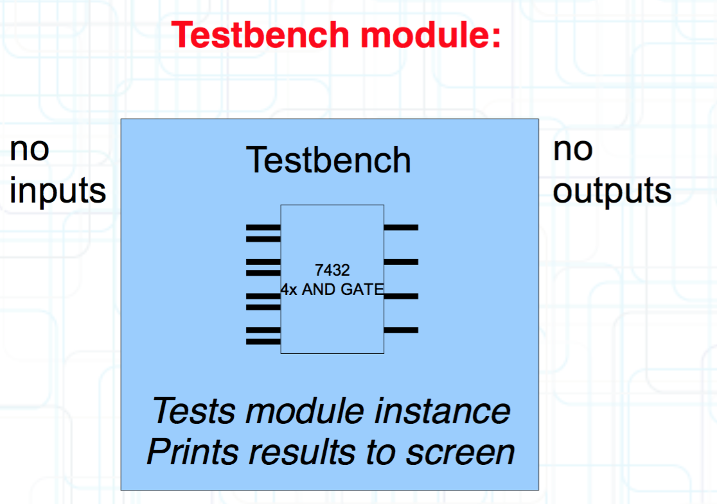
Testbench Idea
Testbench modules
No inputs, no outputs (as connections)
Access to screen, keyboard, time
Access to tested module instance

Slide 7
Testbench Idea
Same as plugging a chip to a physical test board which tests various inputs and blinks green light if everything is OK.
You don't have to blink a green light:
HDLs provide a way to write to screen:
TEST1 passed
TEST2 failed
TEST3 passed
…

Slide 8
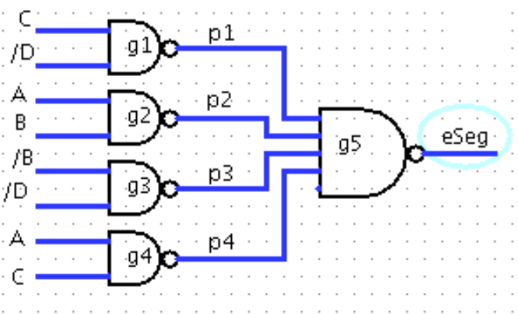
A Simple Verilog Example
module binary_to_eseg(
input A, E input B,
input C,
input D,
output eSeg
);
wire p1, p2, p3, p4;
nand2 g1(p1, C, ~D);
nand2 g2(p2, A, B);
nand2 g3(p3, ~B, ~D);
nand2 g4(p4, A, C);
nand4 g5(eSeg, p1, p2, p3, p4);
endmodule

Slide 9
Tools
Xilinx ISE WebPack (version 12.4)
Integrated Development Environment
Editor, compiler, simulator, FPGA programmer
Linux & Windows
Free to use
Installation requires free registration and obtaining free license.
www.xilinx.com
We will use Xilinx version 12.4, please don't use other versions

Slide 10

Installation

Slide 11
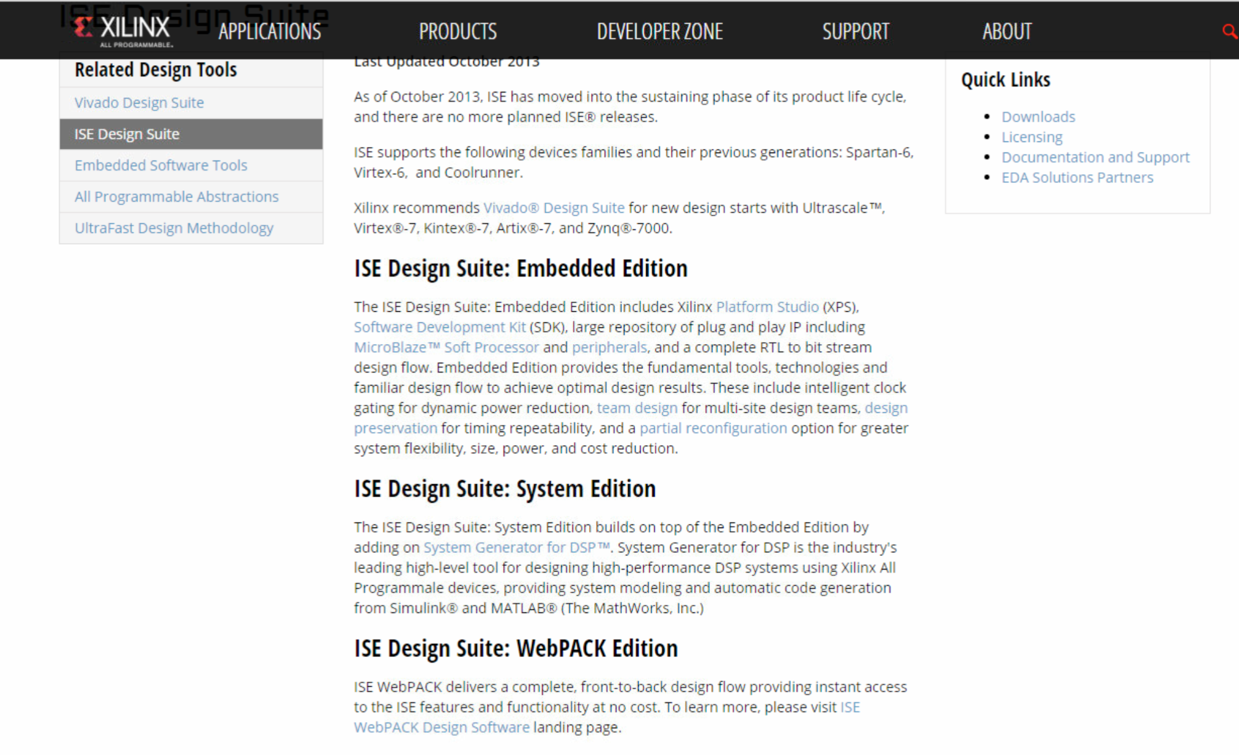
Installation (Cont.)

Slide 12
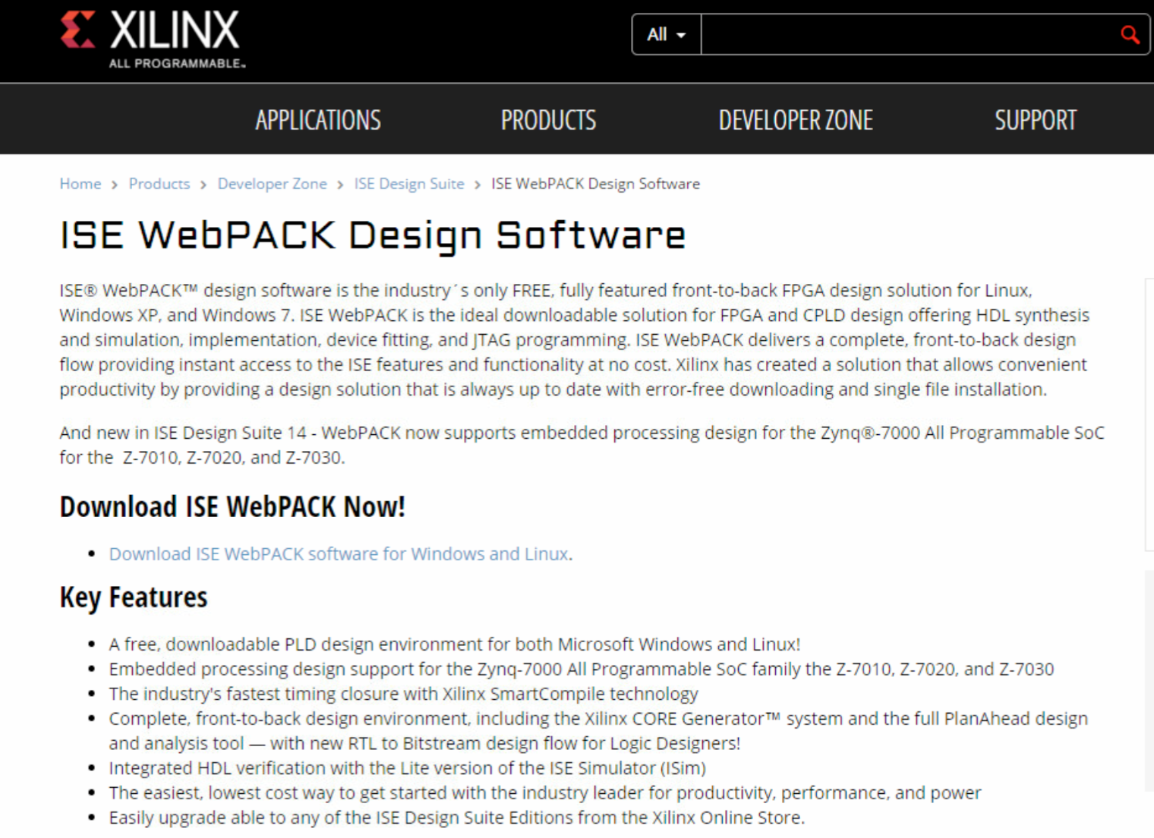
Installation (Cont.)

Slide 13
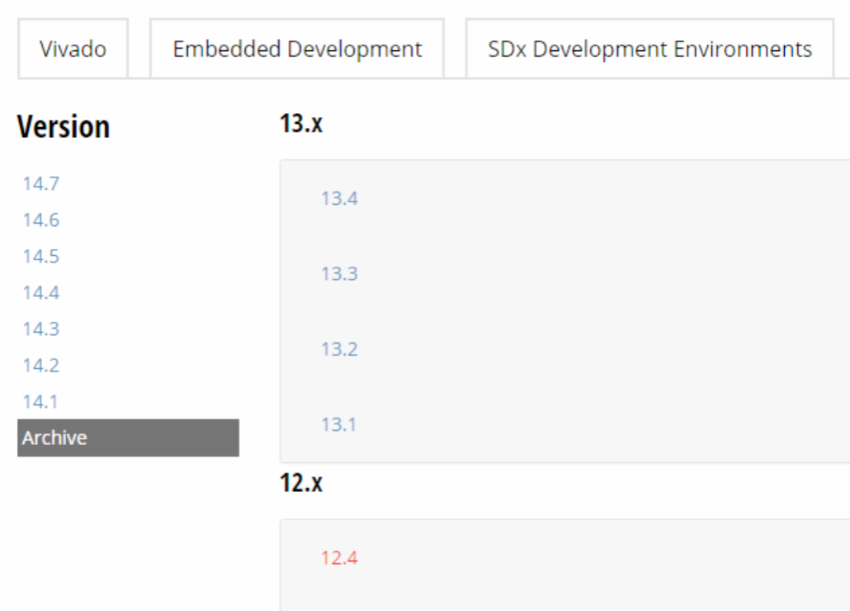
Installation (Cont.)

Slide 14
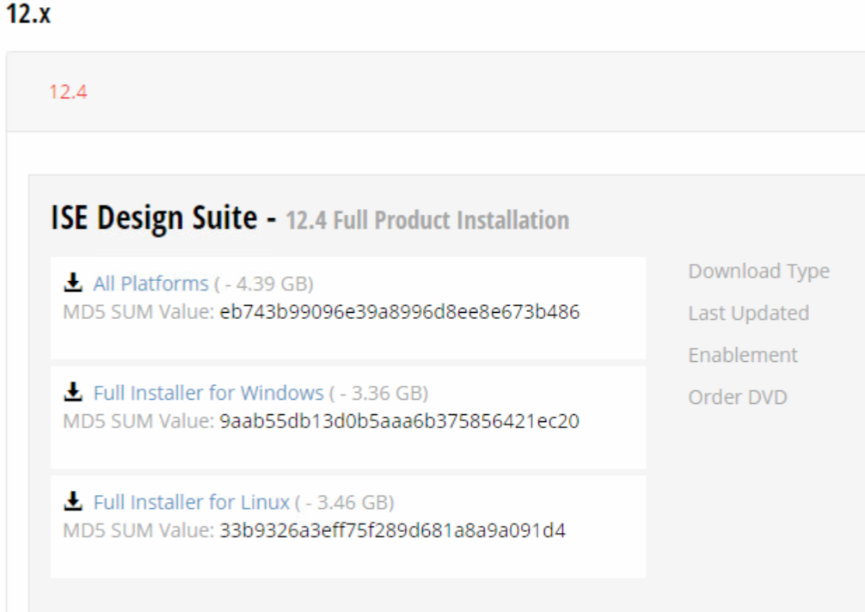
Installation (Cont.)

Slide 15
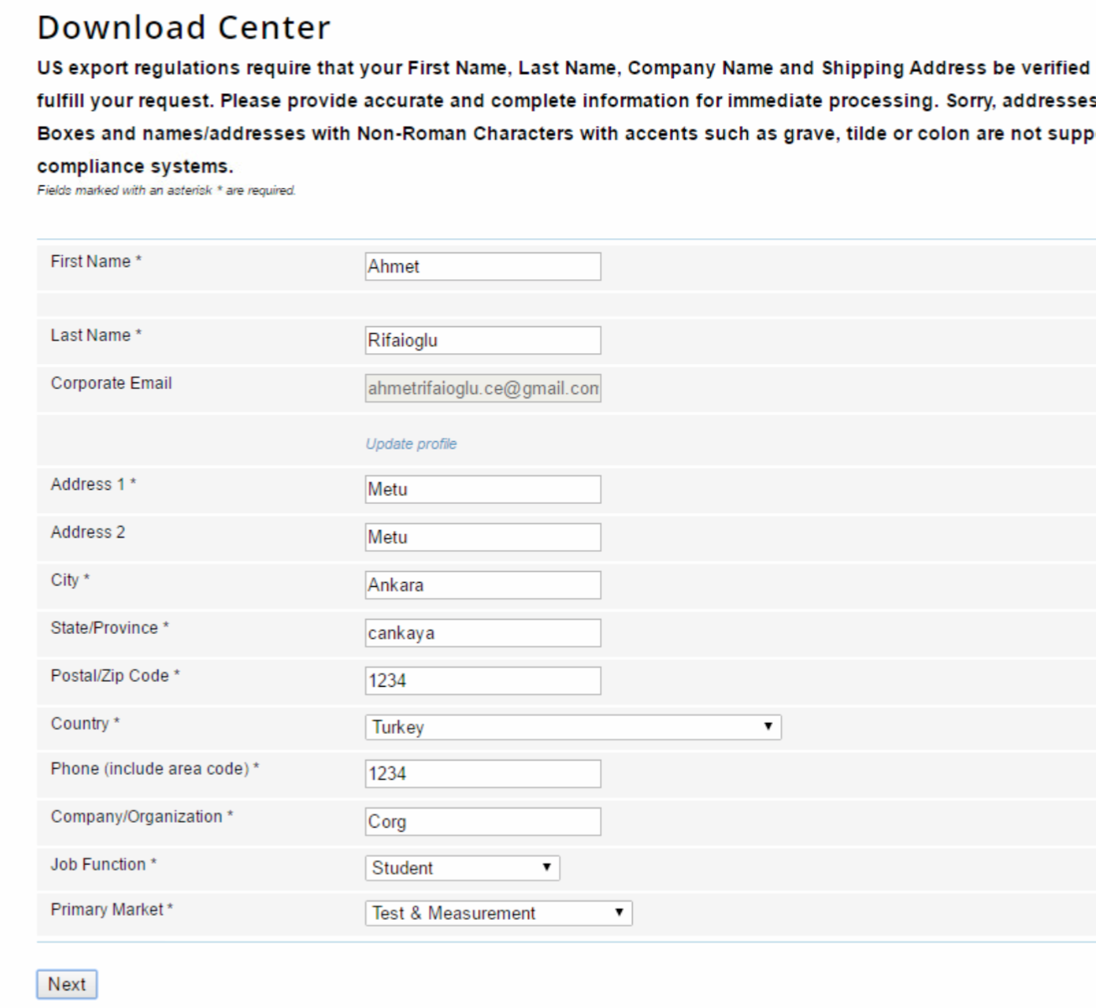
Installation (Cont.)

Slide 16
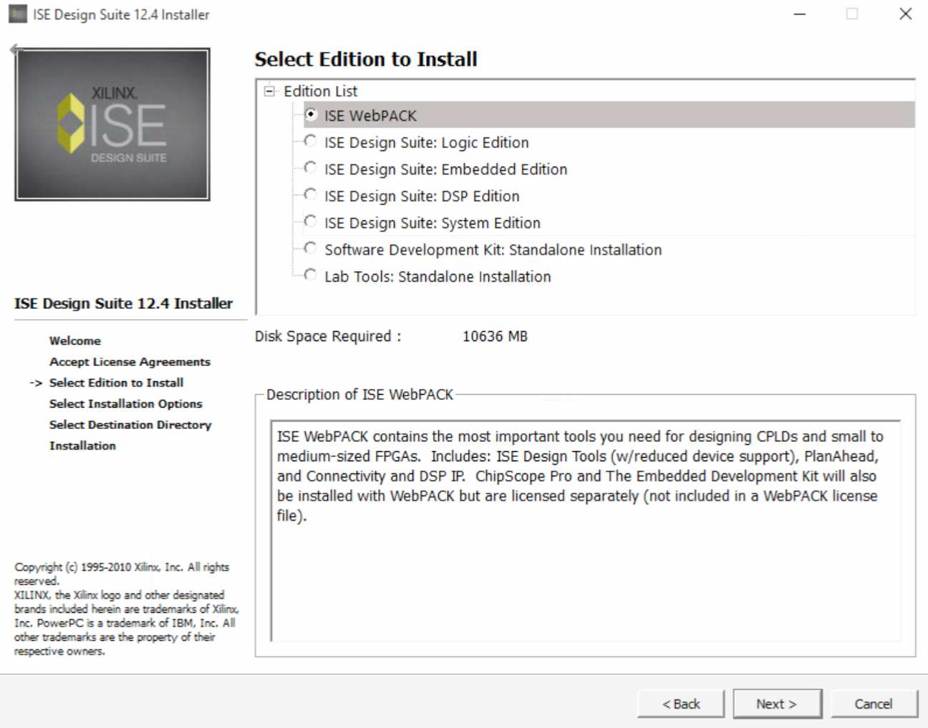
Installation (Cont.)

Slide 17
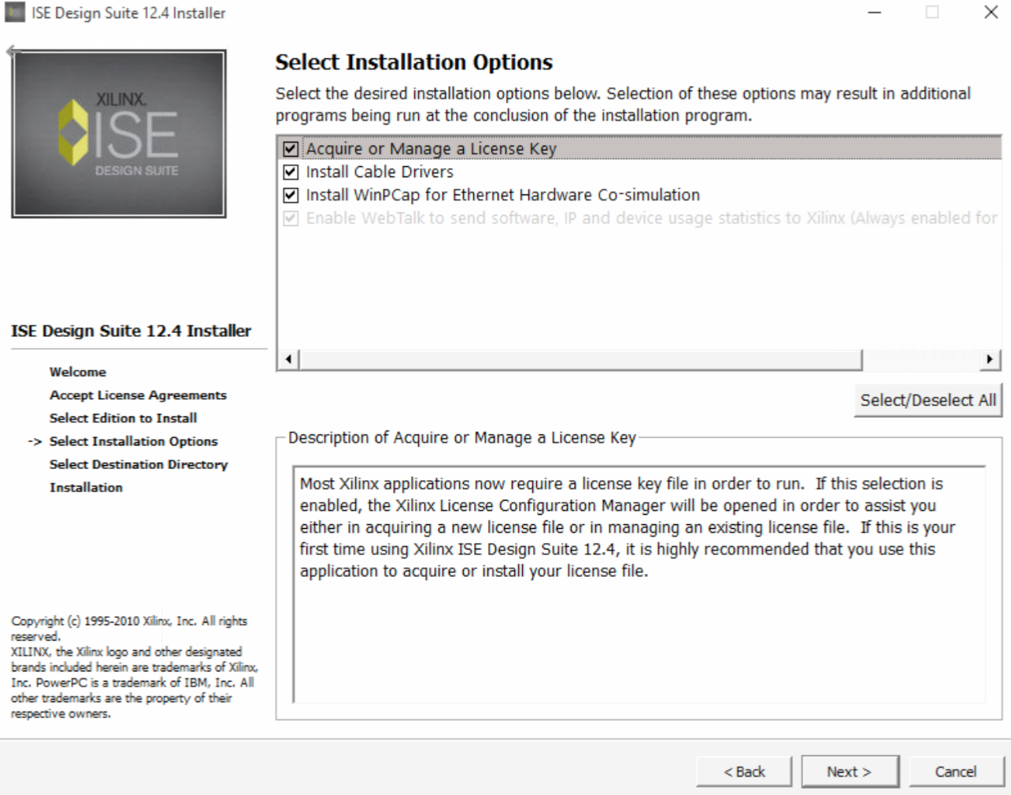
Installation (Cont.)

Slide 18
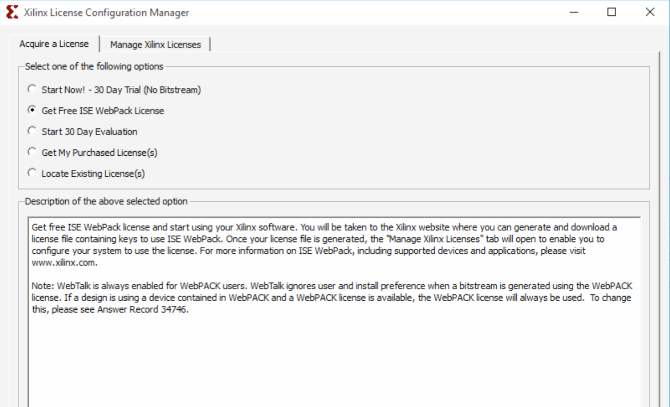
Installation (Cont.)

Slide 19
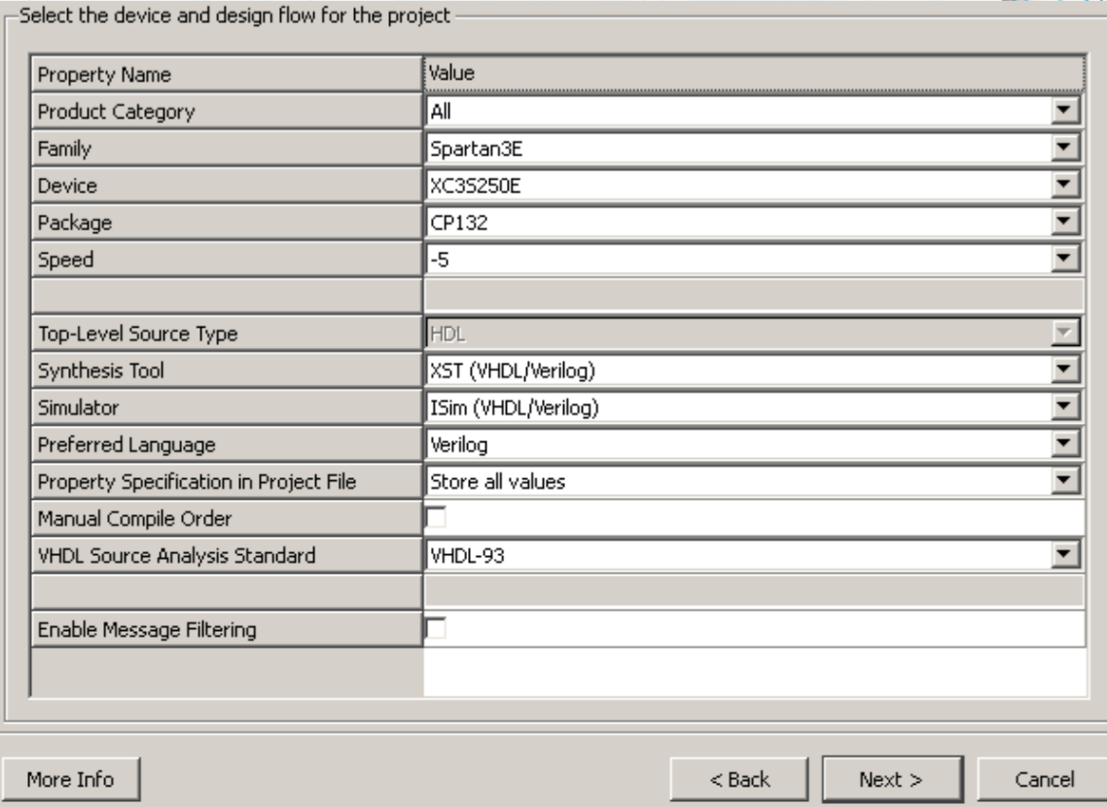
Creating Project
Open ISE Design Tools → Project Navigator
Create new project with the following options

Slide 20
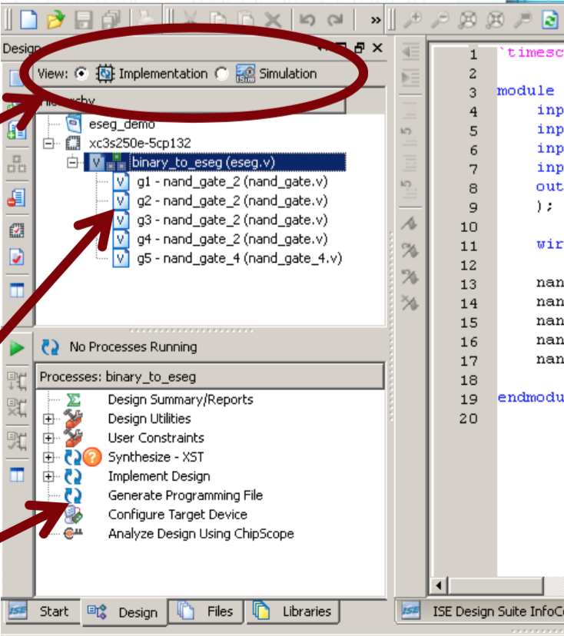
Basic Properties of Xilinx
2 Design modes:
Implementation
Simulation
Top
Module hierarchy
Bottom
Actions with
Selected module

Slide 21
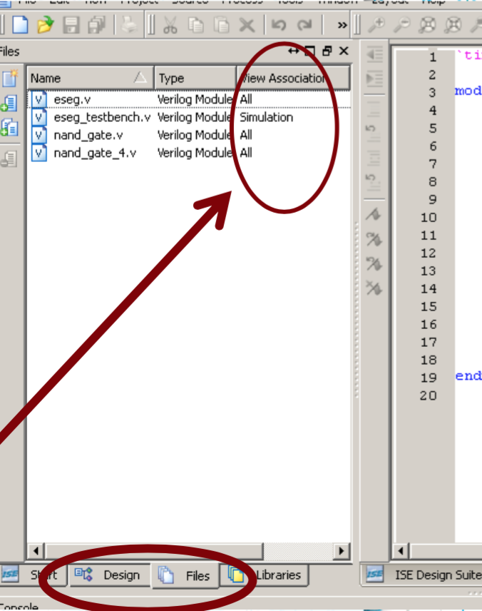
Basic Properties of Xilinx
You can switch between Design and Files views
A file may belong to:
Implementation only
files related with FPGA board
Simulation only
Testbenches …
Both
Your design

Slide 22
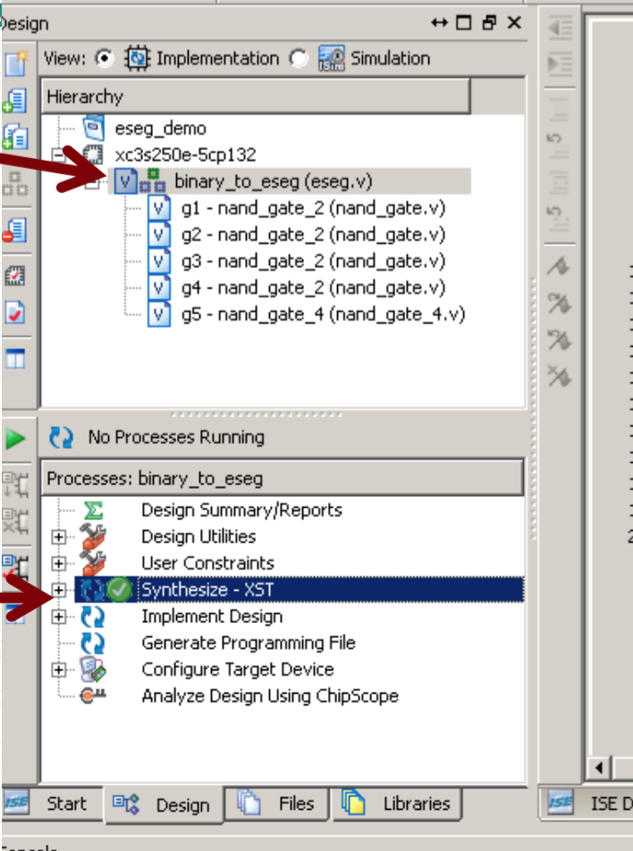
Compiling, checking syntax errors
Choose desired module
All dependencies will also be compiled
Compiler output will be shown in the bottom
In implementation mode
Double click on Synthesize
OR in simulation mode
Double click on Behavioral Check Syntax

Slide 23
Simulation
Special commands can be used inside simulation source-files:
$finish,$stop,$monitor,$display,..
Results of these are seen on output panel
Also, wire values of any module can be seen in timing diagram panel

Slide 24
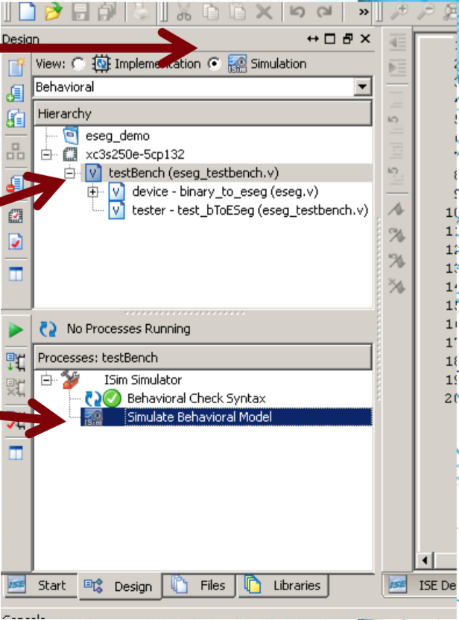
Simulation (Cont.)
In simulation mode
Select testbench module
Double click on Simulate Behavioral Model
Dependencies will be compiled
ISim Simulator will be opened

Slide 25
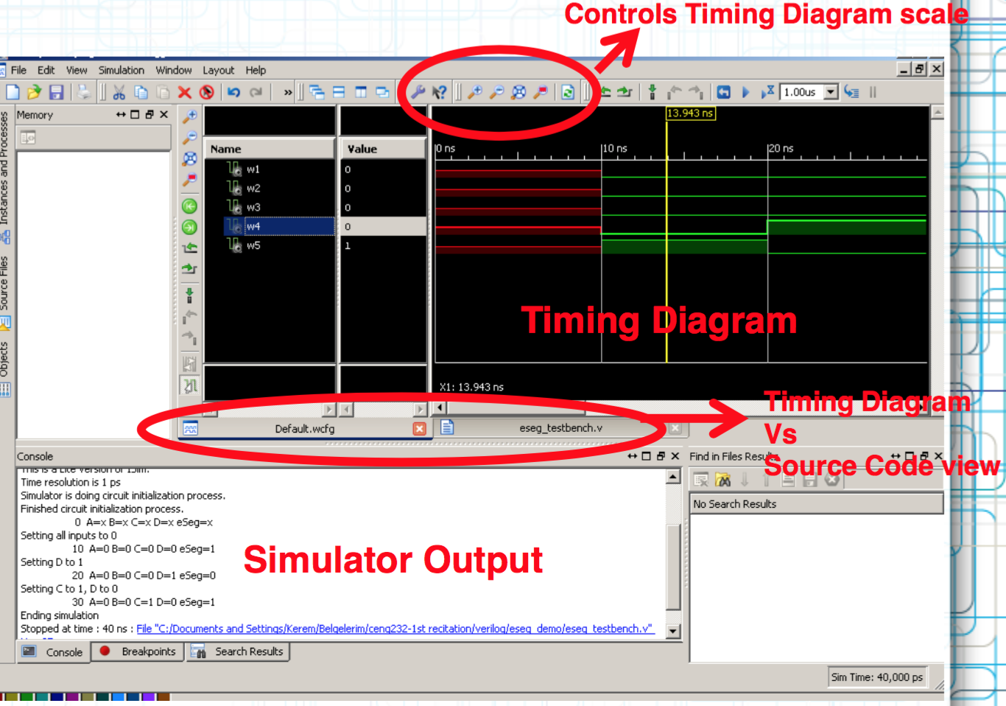
Isim Simulator

